Slide 1
🔧📊Data Engineering Workshop
April 2025
Alexandros Argyou, Rahul Maddineni

Slide 2
Agenda
📌 Introduction to Data Engineering Overview: Building and maintaining data systems for analysis and ML.
Responsibilities: Data pipelines, quality assurance, and team collaboration.
🛠 The Data Engineering Stack
Data Life Cycle: Different steps in life cycle of Data Engineering Transformations: ETL, ELT
Data Modelling Concepts
🏗 Storage Paradigms and Medallion Architecture
Storage Paradigms: Warehouses, Lakes and Lakehouses
Medallion Architecture: How to structure scalable, maintainable data pipelines.
Batch and Streaming
Popular Tools
🚀 Hands-on Pipeline Build Go from raw data to business metrics in a mini project.

Slide 3
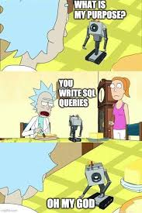
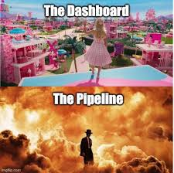
Introduction to Data Engineering

Slide 4
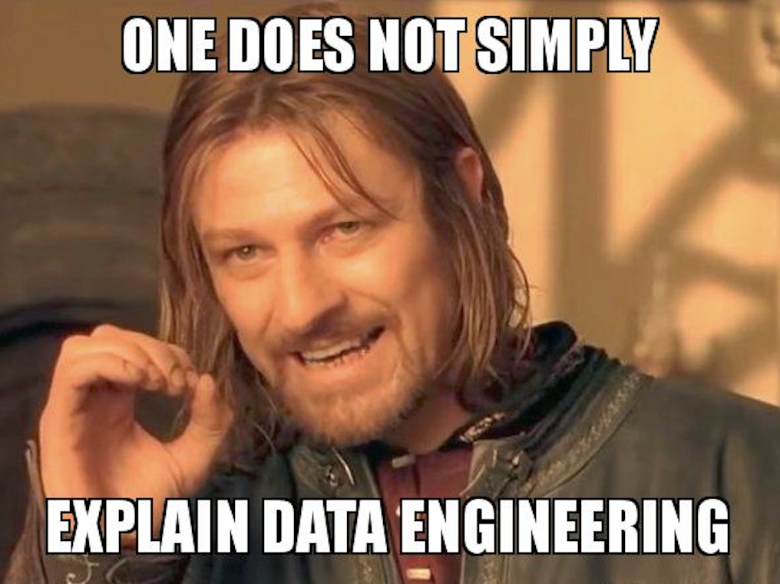
What is Data Engineering?
Data engineering involves designing, building, and maintaining systems and infrastructure that enable the collection, storage, and transformation of raw data into usable formats for analysis and machine learning.
Key Responsibilities:
Build Scalable Data Pipelines Automate data collection, transformation, and delivery across systems.
Ensure Data Quality & Availability Validate and monitor data for consistency, accuracy, and accessibility.
Optimize for Performance Tune infrastructure to handle large data volumes efficiently.
Collaborate with Data Teams Work closely with analysts and scientists to provide the right data for insights and models.

Slide 5
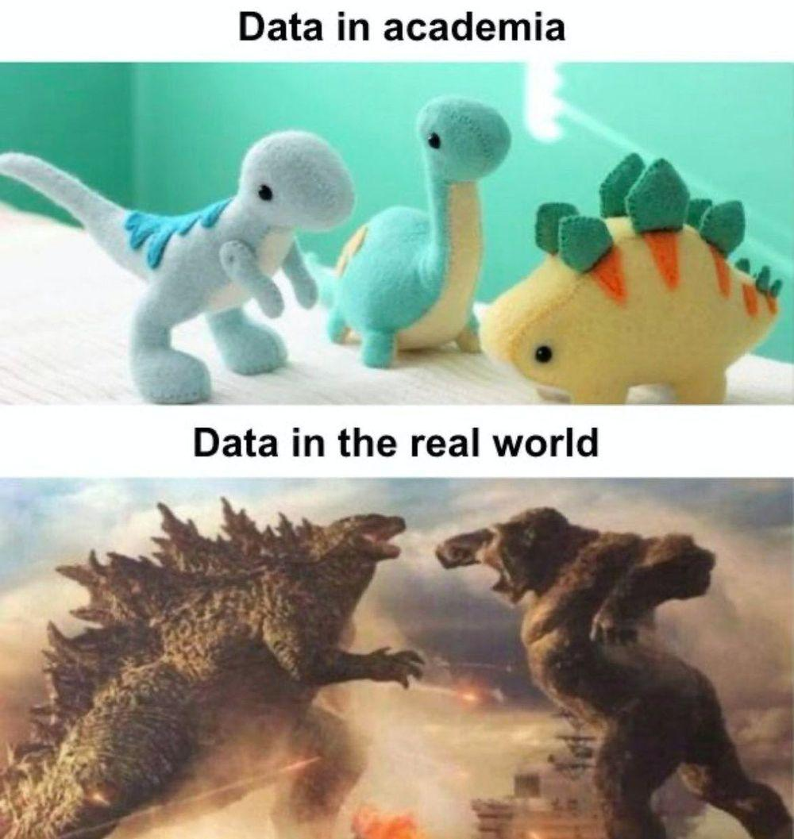
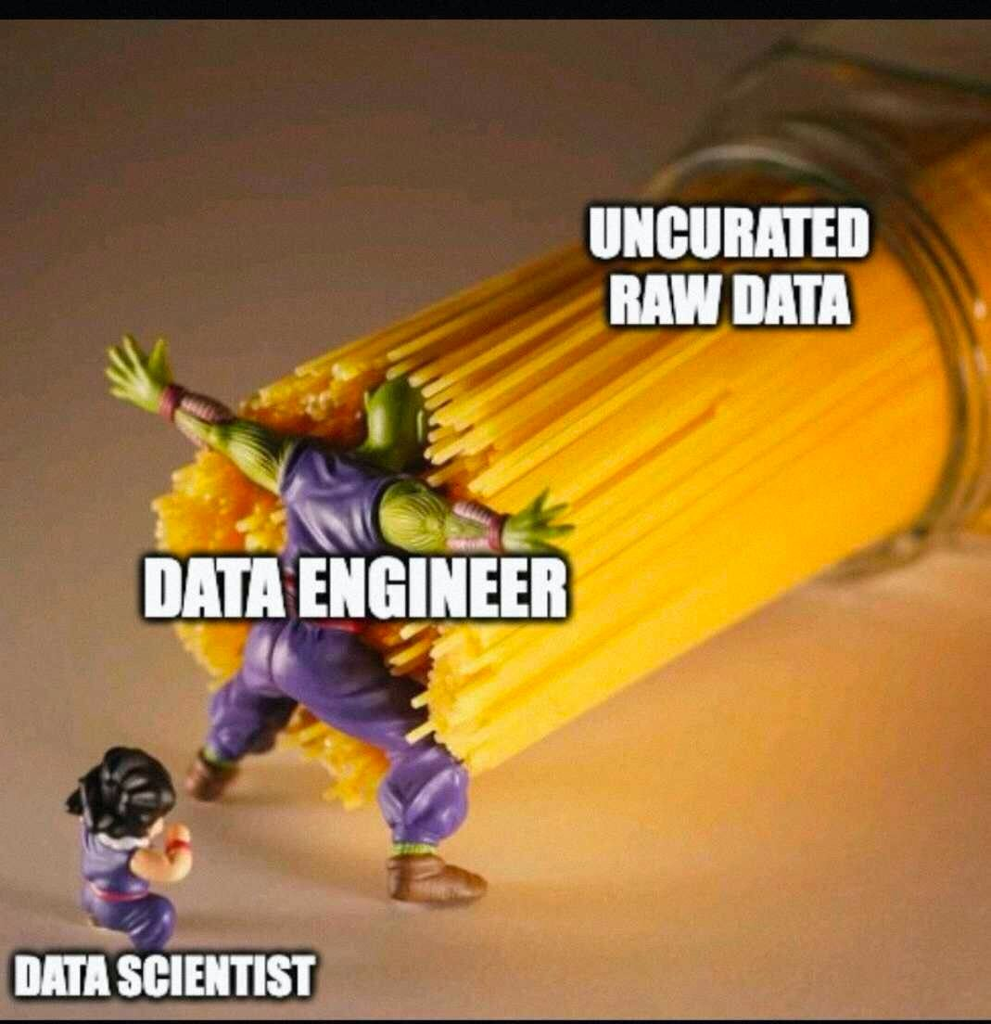
Why is Data Engineering important?

Slide 6
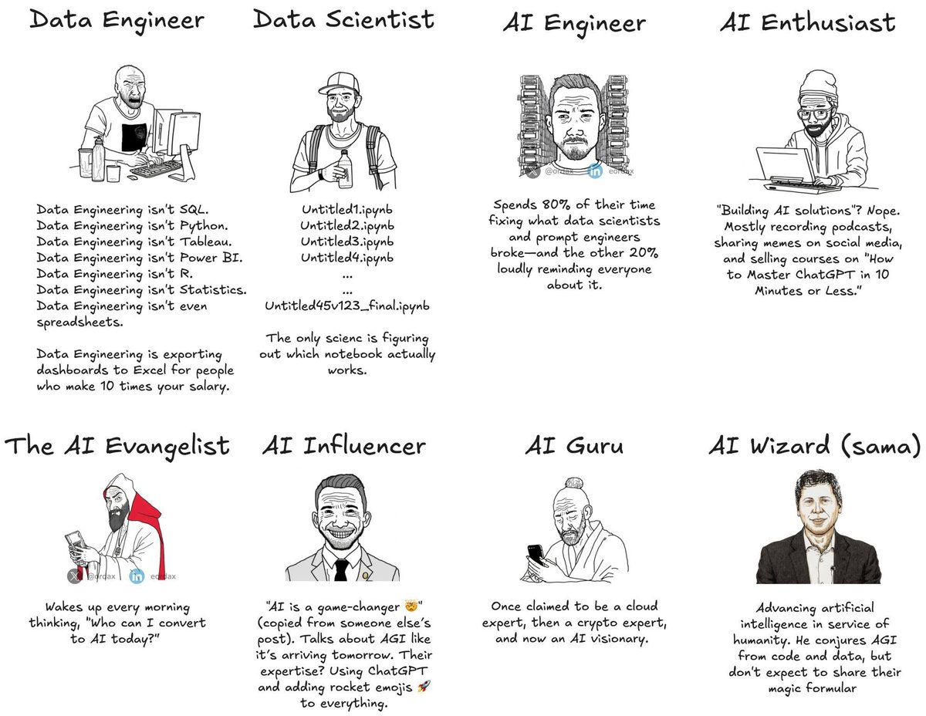
Why Data Engineering? How is it different?
Makes Data Usable Engineers clean and organize raw data so others can work with it easily.
Saves Time for Everyone Good pipelines mean less time fixing broken data and more time analyzing it.
Keeps Things Running Smoothly Data engineers make sure data shows up where it’s needed, when it’s needed.
Supports Deeper Analysis Without solid data systems, even the best models and dashboards fall apart.
Helps Teams Work Together Engineers connect different tools and systems so teams don’t have to.

Slide 7
Data Life Cycle
1. Ingestion
➡ Collecting data from various sources like APIs, files, logs, streaming platforms, and databases.
➡ Tools: Kafka, Airbyte, Fivetran.
2. Storage ➡ Storing raw or semi-processed data in scalable and cost-effective platforms. ➡ Types: Data Lakes (S3, GCS), Warehouses (Snowflake, BigQuery), Lakehouses (Delta Lake).
📌 Key Insight: Not all data needs to go straight to a warehouse. Raw storage allows replay and flexibility.
3. Transformation
➡ Cleaning, validating, and reshaping data into analysis-ready formats.
➡ Tools: dbt, Spark, SQL.
4. Serving ➡ Making the processed data available for downstream use – dashboards, ML models, apps. ➡ Tools: Looker, Tableau, Power BI, APIs.
5. Monitoring & Governance ➡ Ensuring data trust through quality checks, privacy policies, and observability. ➡ Practices: Data lineage, audits, alerts (using tools like Great Expectations, Monte Carlo).
🧠 Reminder: Every organization customizes this flow based on scale, use case, and maturity.

Slide 8
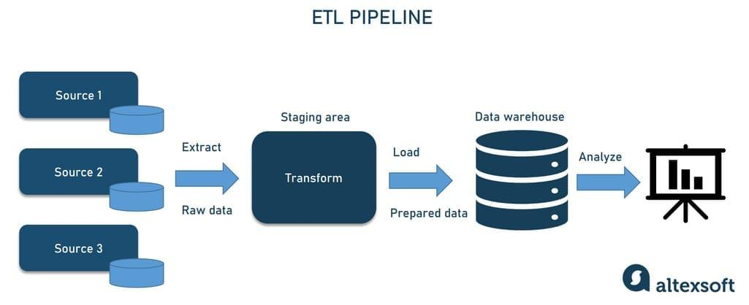
Data Life Cycle

Slide 9
🏢 Example: How Companies Tailor the Data Lifecycle
Enterprise: Scalable Systems Inc.
Goal: Scalable, automated, and governed pipelines Ingestion: Kafka, Airbyte, custom connectors in Python
Storage: Lakehouse on S3 with Delta Lake (Parquet format with lifecycle policies)
Transformation: Declarative models in dbt, scalable jobs with Spark/PySpark, scheduled via Airflow
Serving: BI dashboards in Tableau, production-grade APIs built with FastAPI or Flask
Monitoring & Governance: Great Expectations, Monte Carlo, built-in logging, Python-based alerting scripts 🧠 Focus: Performance, governance, and production-readiness at scale.
🔹 Startup: Quick Insights Co
Goal: Fast experimentation, lean setup
Stack:
Ingestion: REST APIs, flat files using Python scripts
Storage: AWS S3 Buckets (Files), AWS RedShift (Database)
Transformation: Ad hoc SQL in notebooks, Dockerized Python/pandas scripts in AWS
Serving: PowerBI Dashboards
Monitoring: Manual checks, Logging in scripts (S3 Buckets)
🧠 Focus: Speed and flexibility over automation and robustness.

Slide 10
Transformation Processes
🧱 ETL: Extract → Transform → Load
Data is cleaned and reshaped before storage.
Used in traditional data warehouses, especially on-premise systems.
Good when:
There are tight constraints on storage or compute.
Data volumes are small to moderate.
Security or regulatory policies require cleaning before storage.
🔧 Typical tools: Informatica, Talend, custom Python scripts

Slide 11
Transformation Processes
🧪 ELT: Extract → Load → Transform
Raw data is stored first, then transformed inside the target system (lake/warehouse).
Suited for cloud-native architectures.
Good when:
You need flexibility (change logic without re-ingesting).
Teams want to collaborate on transformations using SQL or dbt.
Storage is cheap and scalable (e.g., S3, GCS, ADLS).
⚙️ Modern stack: dbt + Snowflake / BigQuery / Databricks

Slide 12
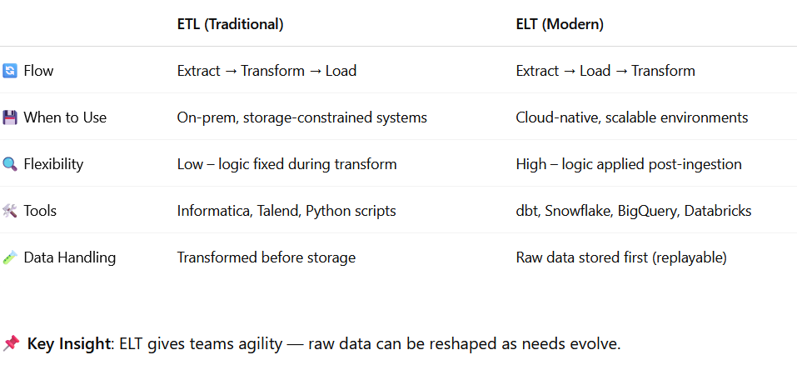
ETL vs ELT – What's the Difference?

Slide 13
Why ELT is Now the Standard
📈 How the Trend Evolved
2000s – ETL dominated: on-prem data warehouses, small data volumes.
2010s – Cloud shift: storage got cheaper, compute scalable → ELT rises.
Now – ELT with Medallion Architecture enables replayable, governed pipelines.
✅ Benefits of ELT Today
Store raw, reusable data.
Use powerful SQL-based workflows (e.g., dbt).
Enable modular, testable transformations.
Easier debugging and governance.
📌 Takeaway: ELT aligns with modern data engineering best practices — scalable, collaborative, and future-proof.

Slide 14
Key Terminologies & Concepts
🧾 Fact Tables
What they are:
Central tables in a data warehouse that record measurable events.
Each row is an event, transaction, or observation.
Key Features:
Contain metrics (e.g., sales_amount, clicks, quantity).
Have foreign keys pointing to dimension tables.
High volume – can contain billions of rows.

Slide 15
Key Terminologies & Concepts
🧭 Dimension Tables
What they are:
Lookup/reference tables that provide context to facts.
Represent the “who,” “what,” “when,” “where.”
Key Features:
Contain descriptive (categorical) attributes.
Typically low cardinality, fewer rows but more columns.
Used for filtering, grouping, and labeling in reports.

Slide 16
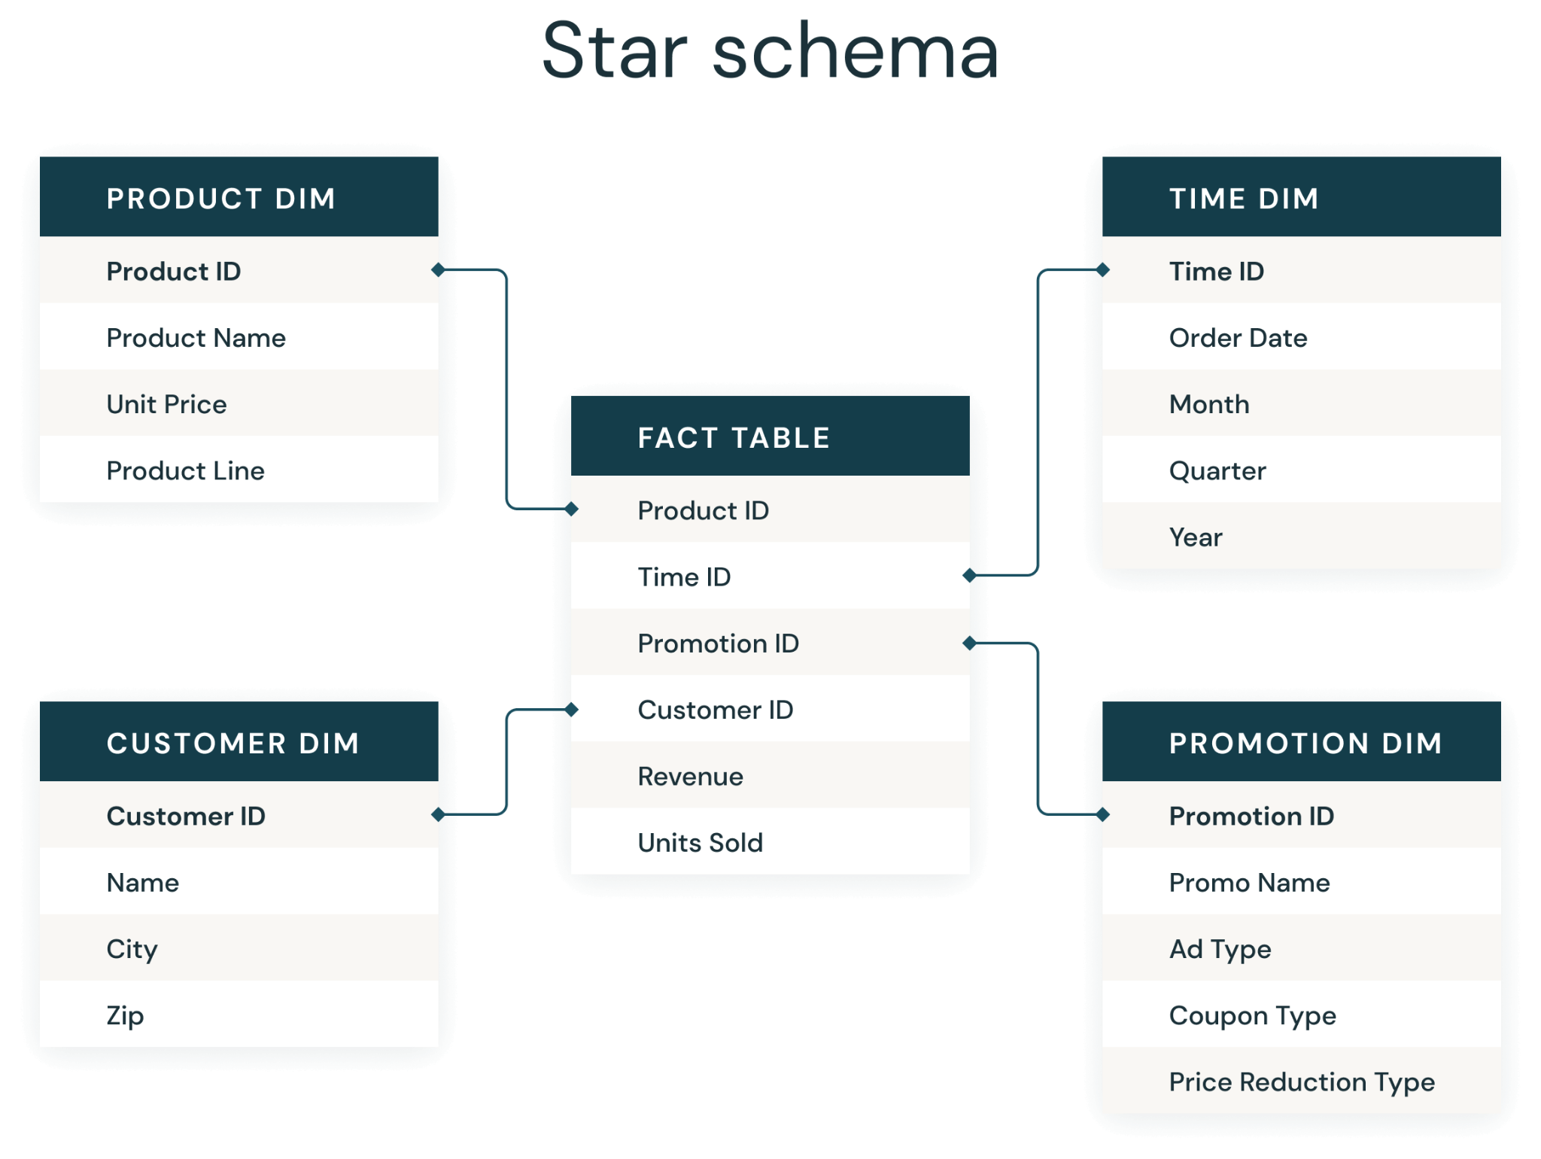
Star Schema
This has a central fact table directly connected to flat dimension tables. This separation of tables improves query performance, and makes data easier to maintain. It’s also simple and intuitive, making it a popular choice for many data warehouses.
Pros:
Simplified queries – fewer joins.
Optimized for read-heavy operations (OLAP).
Easy to understand for business users.
Cons:
Redundant dimension data.
Can be harder to maintain if dimensions change frequently.

Slide 17
Snowflake Schema
In this approach, dimension tables are normalized, meaning they are broken down into additional tables to reduce redundancy. While more complex, this can lead to even better data organization and potentially improved query performance.
By keeping fact and dimension tables separate, you can more easily manage and analyze large datasets, ensuring that your data warehouse remains organized and consistent.
Pros:
More efficient storage and maintenance.
Helps when dimensions have hierarchical relationships (e.g., country → region → city).
Cons:
More complex queries with multiple joins.
Slower performance for BI dashboards.

Slide 18
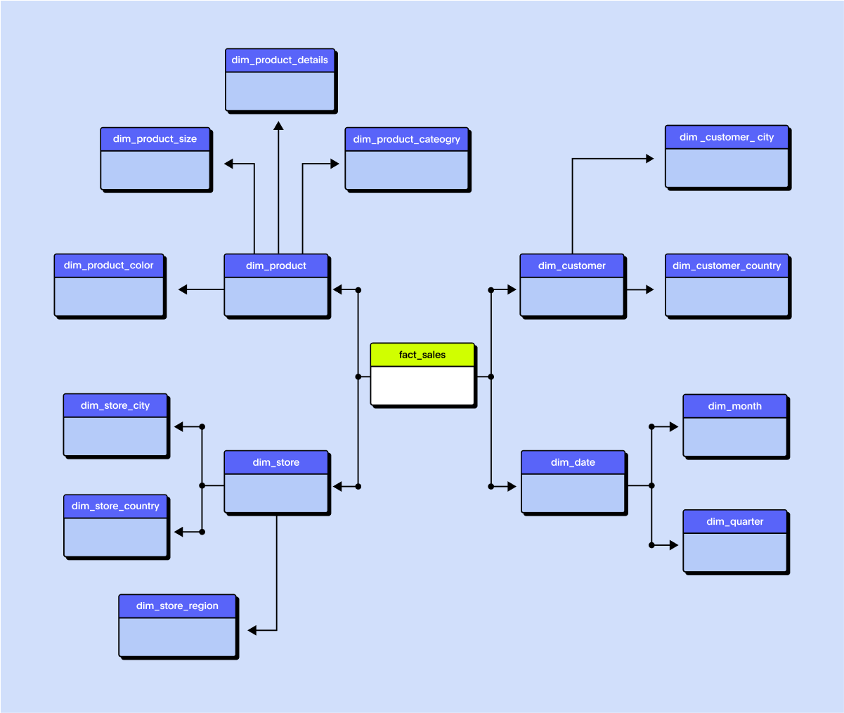
Snowflake Schema

Slide 19
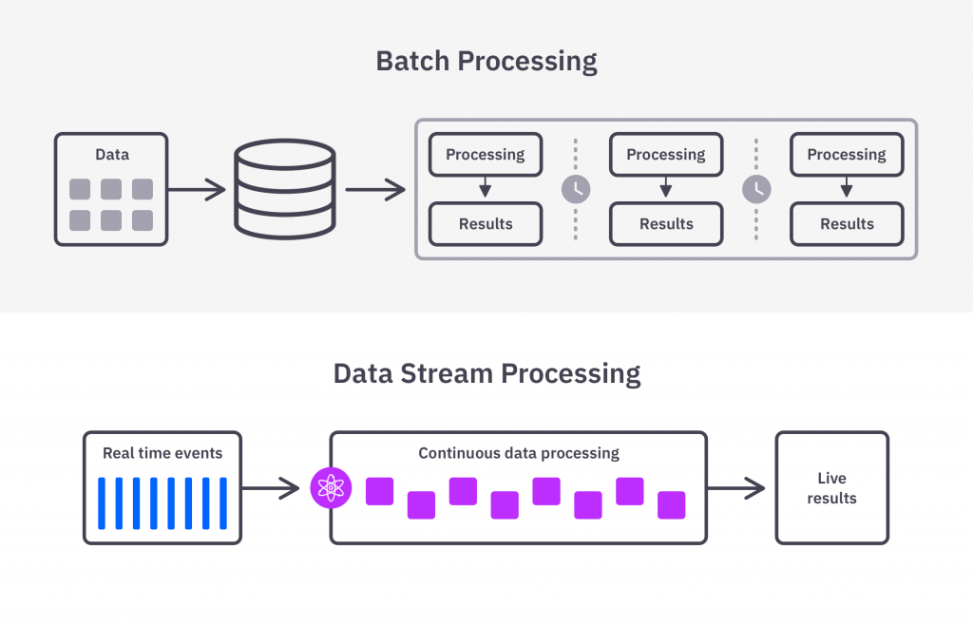
Batch vs Streaming
Aspect | Batch | Streaming
Frequency | Periodic (hourly/daily) | Real-time (seconds/millis)
Use Cases | Reports, dashboards | Fraud detection, alerts
Complexity | Easier to implement | More complex infrastructure

Slide 20

Storage Paradigms
1. Data Warehouse
Structured, analytics-focused (e.g., BigQuery, Redshift, Snowflake)
Great for business intelligence
2. Data Lake
Store raw data in various formats (e.g., CSV, JSON, Parquet)
« Cheap » and flexible (e.g., S3, ADLS, HDFS)
3. Lakehouse
Combines best of both
Supports BI + ML + raw storage
Popular tools: Databricks Delta Lake, Apache Iceberg

Slide 21
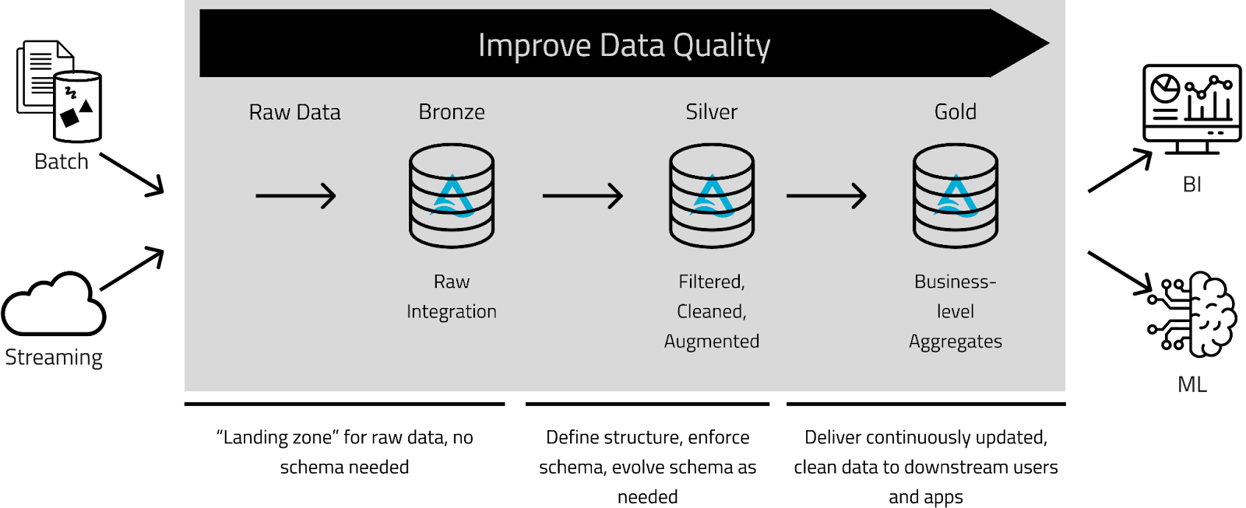
Medallion Architecture

Slide 22
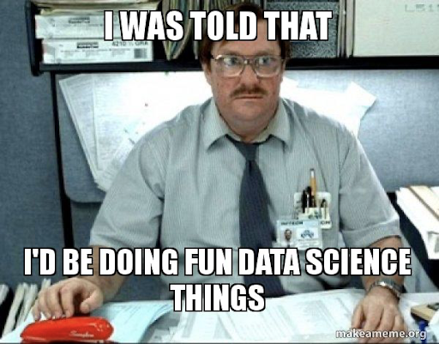
The Proof Is in the Pudding (aka Notebook)

